Slide 1
TIBCO BusinessEvents BPMN Runtime
Update – Apr 2011
Pranab Dhar, Suresh Subramani
Quantum Leap R&D
This document (including, without limitation, any product roadmap or statement of direction data) illustrates the planned testing, release and availability dates for TIBCO products and services. This document is provided for informational purposes only and its contents are subject to change without notice. TIBCO makes no warranties, express or implied, in or relating to this document or any information in it, including, without limitation, that this document, or any information in it, is error-free or meets any conditions of merchantability or fitness for a particular purpose. This document may not be reproduced or transmitted in any form or by any means without our prior written permission.
Notes:
Welcome. Thank you for the opportunity to tell you more about TIBCO and how we can help you. Let me introduce my team….

Slide 2
Disclaimer
This presentation (including, without limitation, any product roadmap or statement of direction data) illustrates the planned testing, release and availability dates for TIBCO products and services. This document is provided for informational purposes only and its contents are subject to change without notice. TIBCO makes no warranties, express or implied, in or relating to this document or any information in it, including, without limitation, that this document, or any information in it, is error-free or meets any conditions of merchantability or fitness for a particular purpose. This document may not be reproduced or transmitted in any form or by any means without TIBCO’S prior written permission.
THIS PRESENTATION CONTAINS PRIVILEGED AND CONFIDENTIAL INFORMATION PROVIDED TO OR FOR THE BENEFIT OF TIBCO SOFTWARE INC. AND ITS AFFILIATES. ANY INFORMATION CONTAINED IN THIS PRESENTATION IS FOR THE SOLE USE OF THE INTENDED RECIPIENTS. ANY REVIEW, COPYING OR DISTRIBUTION OF THIS PRESENTATION BY OTHERS IS STRICTLY PROHIBITED.

Slide 3
Agent architecture
BPMN Agent is similar to an Inference agent which leverages the agent architecture for the following features.
Distributed execution
Distributed data storage
Centralized deployment
Failover/Failback support
Recovery support
Inferencing capabilities
Process Execution semantics
Messaging support
API/Rule language support
Ontology support

Slide 4



Execution model
Proc.
Unit
Runtime Process
Definition
Process Artifacts
Rules
Rule functions
Job concept
Events
Itinerary & steps
Mapping to business artifacts
Business Artifacts
Rule
Rule functions
Concepts
Events
Decision Tables
Messaging channels
X
Single Process Engine
Process
Agent
Inferencing module
Job X-1
Job X-2
Rete
Working Memory
X
Y
Collaboration
Process Engine
Job X-1
Inferencing module
Job X-2
Job Y-1
Rete
Working Memory

Slide 5
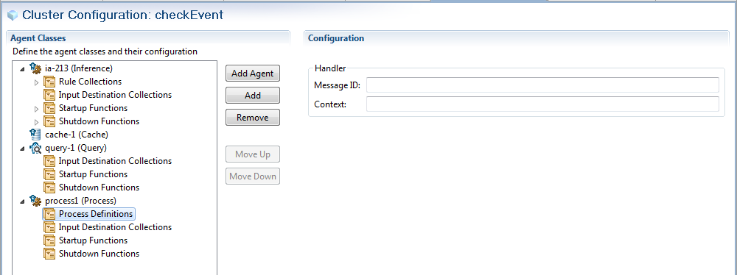
Process Deployment configuration

Slide 6
Process Deployment Config
<agent-classes>
<process-agent-class id=“pa-100">
<load> <max-active/> </load>
<process-engine id=“pe-01” > {0..*}
<process > <uri/>{ 1..*}</process>
<startup> <uri/>{0..*} </startup>
<shutdown> <uri/>{0..*}</shutdown>
<rules><uri/>{0..*}</rules>
<destinations><uri/>{0..*}</destinations>
<property-group/>
<job-manager id=“jm-01”>
<job-queue-size/>
<thread-pool size/>
</job-manager>
<inference-engine id=“ie-01”>
<local-cache> <eviction> <max-size>1000</max-size> <max-time>3600</max-time> </eviction> </local-cache>
<shared-queue> <size>1024</size> <workers>10</workers> </shared-queue>
<concurrent-rtc>false</concurrent-rtc>
<check-for-duplicates>false</check-for-duplicates>
<property-group/>
</inference-engine>
</process-engine>
</process-agent-class>
</agent-classes>

